Slide 1
FINAL YEAR PROJECT PAPER
(FYP)
Prepared by:
FYP Coordinators

Slide 2
FIN672
Finance
BM242
ISB672
Islamic Banking
BM249
INV667
Investment
BM251

Slide 3
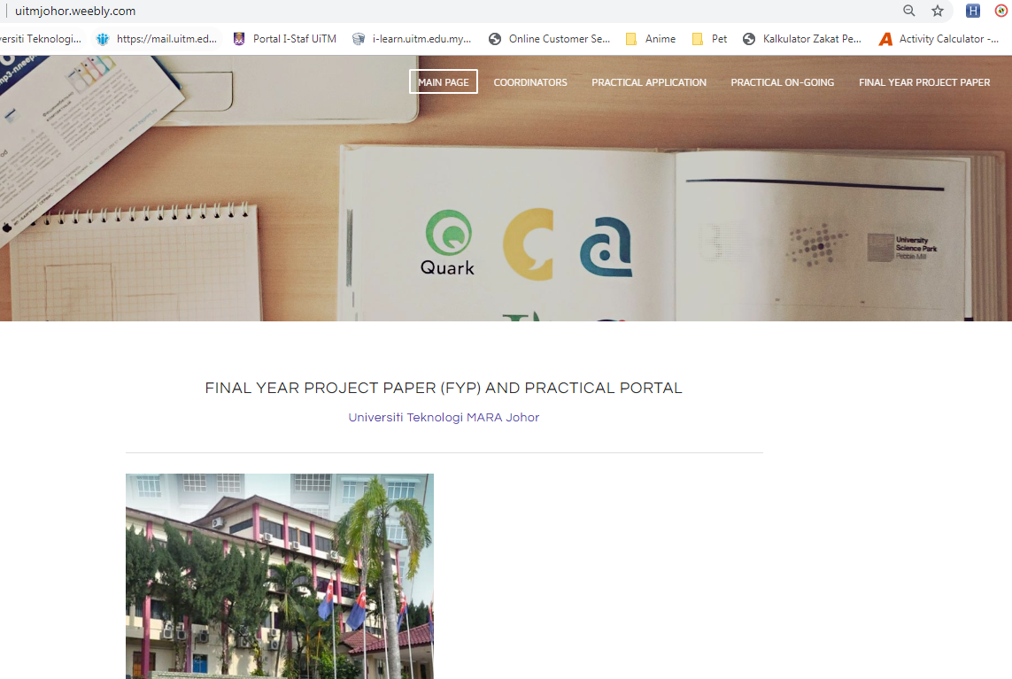
1) uitmjohor.weebly.com
2) Click this link.

Slide 4
IMPORTANT DATES!!!
Date | Assignment to be submitted
4 July 2019 | Announcement for list of advisors in Weebly
8 August 2019 | Due for TWO copies of abstracts
13 August 2019 | Due for Google Form FYP registration
22 September 2019 | Announcement for list of 2nd examiners in Weebly
1 October 2019 | Due for TWO copies of Final Proposal
10 November 2019 | FYP Data Analysis Seminar
8 December 2019 | Announcement for list of presentation panels in Weebly
15 December 2019 | Due for TWO copies of Final Report I - for two Panels of Presentation
22 December 2019 | FYP Presentation
29 December 2019 | Due for THREE copies of Final Report II ( 2 for hardcover bind + 1 for book bind)

Slide 5
YOUR FYP COORDINATORS
Coordinator | Name | Office | Phone Number
FIN672 | Nadia Nurul Najwa binti Mohmad Hassan (Whatapps: 018-785 9011) | BK48 | 07-935 2770
INV667 | Kamal Fahrulrazy Rahim | BK66 | 07-935 2836
ISB672 | Aflah binti Isa @ Darami | BK22 | 07-935 2741

Slide 6
“BEFORE” PRACTICAL training
1
2
3
4
Find out any related topic / issue for your project paper.
Make appointment with your advisor
Discuss your area of research with your advisor
Confirm your research topic with your advisor
Preferably make sure the data required is available.

Slide 7
WHEN TO START?

Slide 8
CONSULTATION
At least 1 MEETING with your advisor before practical training
At least 3 MEETINGS with your advisor during practical training
At least 1 MEETING with your advisor before FYP presentation

Slide 9
CONSULTATION FORM
Print out: uitmjohor.weebly.com

Slide 10
ABSTRACT
1
1

Slide 11
ABSTRACT
2 COPIES OF ABSTRACT (WHITE PAPER)
1 COPY TO YOUR ADVISOR
1 COPY TO YOUR FYP COORDINATOR
MUST SIGN AND APPROVED BY YOUR ADVISOR
SUBMIT BEFORE 3.00 PM
ABSTRACT FORM (WEEBLY)

Slide 12
ABSTRACT FORM
Link: http://uitmjohor.weebly.com/final-year-project-paper.html

Slide 13
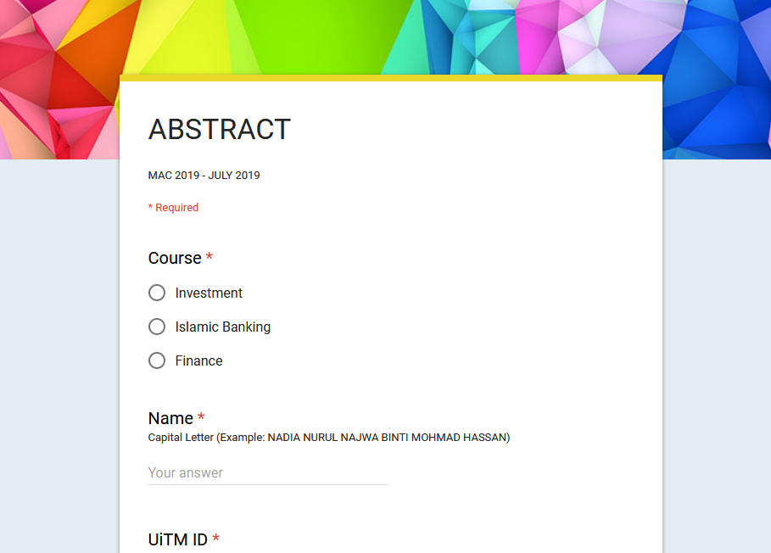
FILL OUT THE “YOUR RESEARCH TOPIC” FORM – Google Form
Link:
Will be shared later.

Slide 14
PROPOSAL
2
2

Slide 15
PROPOSAL FORMAT
RING BINDING
PREPARE 2 PRINTED COPIES
1 COPY TO ADVISOR
1 COPY TO FYP 2ND EXAMINER
COVER PAGE (DIFFERENT COLOUR FOR EACH PROGRAM)
CONTENT (WHITE)
MUST BE SIGNED AND APPROVED BY YOUR ADVISOR BEFORE SUBMITTING TO FYP 2ND EXAMINER
WEEBLY
PRINTED COPY

Slide 16
FINAL REPORT 1
3

Slide 17
FINAL Report 1: BEFORE FYP PRESENTATION
FINAL REPORT 1 FORMAT
RING BIND
2 COPIES
1 FOR PANEL 1
LIST OF PANELS WILL BE UPDATED A WEEK PRIOR TO PRESENTATION
SUBMIT BEFORE
3.00 PM
1 FOR PANEL 2
COVER PAGE:
RUN TURNITIN (CHAPTER 1 –CHAPTER 5)
SCORE < 40%
CONTENT (WHITE)
FIN : YELLOW
ISB : LIGHT GREEN
INV: LIGHT PINK

Slide 18
PROJECT PAPER PRESENTATION
4

Slide 19
PROJECT PAPER PRESENTATION
Any information will be informed a week before presentation’s date

Slide 20
DURING PRESENTATION
Register your name
Take and fill out 2 presentation’s evaluation forms while registering your presentation
Presentation slides (max 18 slides)
(6 slides per sheet)
Softcopy of data and full report 1

Slide 21
FINAL REPORT 2
5

Slide 22
AFTER PRESENTATION
FINAL REPORT FORMAT
HARD COVER BINDING AND CD (ESTIMATED PRICE : RM100)
SIGN A SUBMISSION FORM - INDIVIDUALLY
SUBMIT BEFORE 3.00 PM
GOOGLE DRIVE TO tesisuitmjohor@gmail.com
SOFTCOPY
1 COPY (HARDCOVER BIND + CD) TO YOUR FYP COORDINATOR
SUBMIT A CONSULTATION FORM & PLAGIARISM REPORT
1 COPY (HARDCOVER BIND + CD) TO YOUR ADVISOR
SAVE AS PDF
FORMAT: PROGRAM CODE_YOUR NAME_UiTM ID
1 COPY (BOOK BIND - NO CD) TO YOUR 2ND EXAMINER

Slide 23
REMEMBER!!
LATE SUBMISSION WILL BE PENALIZED:
10% each day late
Failure to submit by the deadline will result in a GRADE OF 0 (F)
No excuses will be entertained

Slide 24
TOPIC
6

Slide 25
BBA FINACE: Time Series or Panel
BBA ISB: Primary (Questionnaire) or Time Series or Panel
BBA INV : Time Series or Panel
Any related topic in your field
CASE STUDY
INTERVIEW

Slide 26
FORMATTING
7

Slide 27
uitmjohor.weebly.com

Slide 28
PLAGIARISM
8

Slide 29
PLAGIARISM

Slide 30
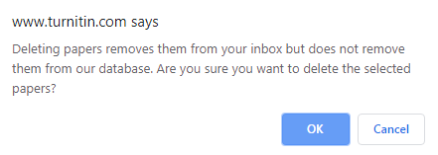
Upload in turnitin class of your course code:
COURSE CODE | CLASS ID | CLASS PASSWORD
FIN672 | 21441548 | fin667
ISB672 | 21433505 | isb672
INV667 | 21433476 | inv667
WARNING:
Do not upload your report in TWO different Turnitin account (lecturer’s account)
Do not upload your report by using TWO different email ID (your Turnitin account)
This will cause the Similarity index to become more than 80% because of duplicate file in Turnitin database. All uploaded report will be used to detect any duplicate file in the future.

Slide 31
FYP ISSUES
9

Slide 32
Q&A

